Slide 1
IOT HW4

Slide 2
Equipment
MPU6050
Raspberry pi
Laptop
Velcro
Breadboard
Wire
Duct tape
Wire Strippers
Solder + Solder Iron
Aluminum Foil
Ethernet Cable (optional)
Cardboard
Door

Slide 3
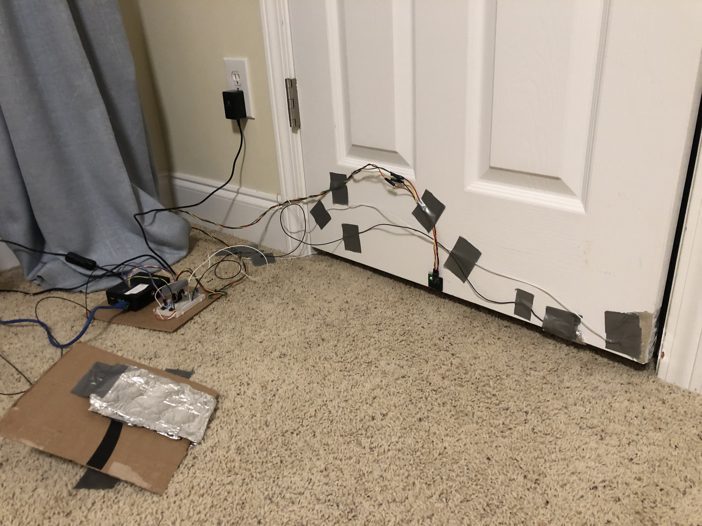
Setup
Pi
MPU6050 Accel/Gyro
Door Close Aluminum Contact Sensor
Door Aluminum Contact Sensors
Door Open Pedal Aluminum Contact Sensor

Slide 4
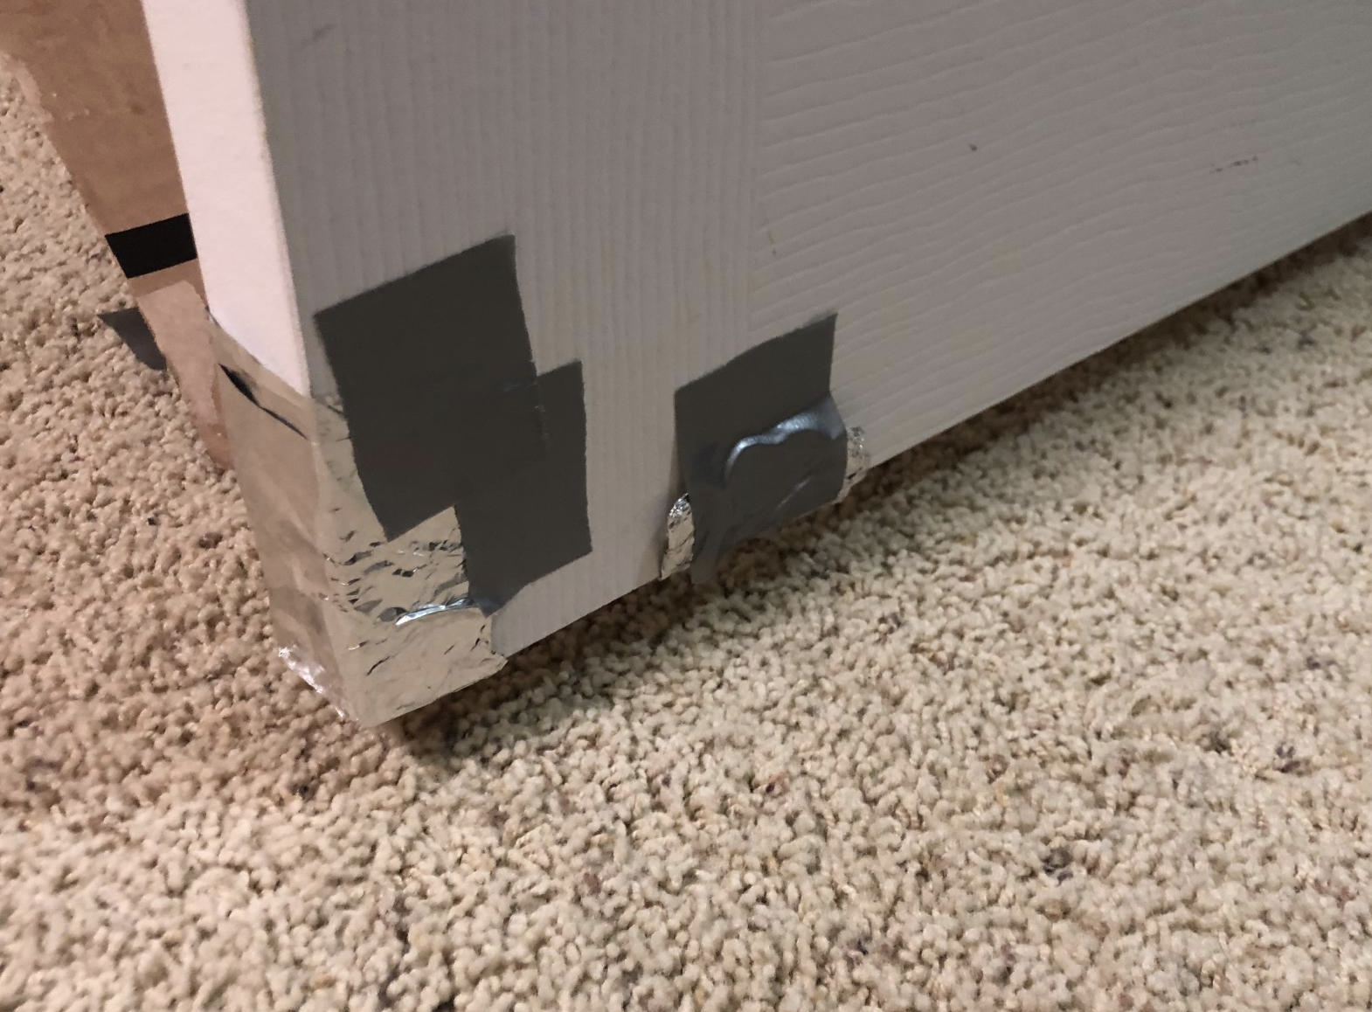


Al Contact Sensor Purpose
The purpose of this sensor is to automatically classify the data collected as a door opening or door closing event
The door has 2 piece of aluminum foil which are NOT in contact with each other
Connects with door frame
Connects with cardboard pedal

Slide 5
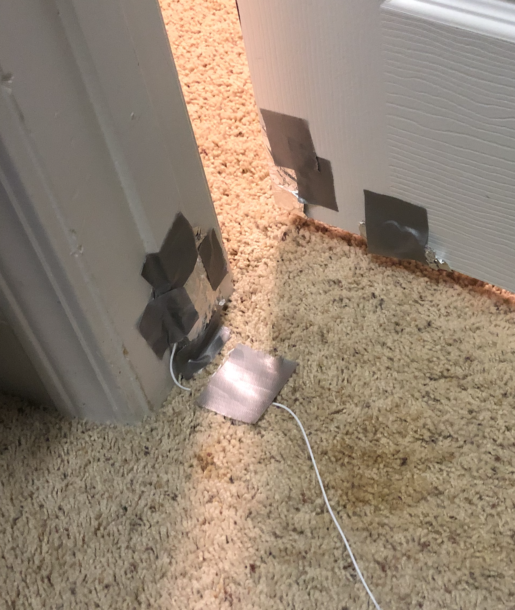
Al Contact Sensor 1 – Door Frame
Either 1 or 2 must be connected to 3.3 volts, the other to an input pin pin.
When contact is lost, the door is opening
When contact is made, the door is closed

Slide 6
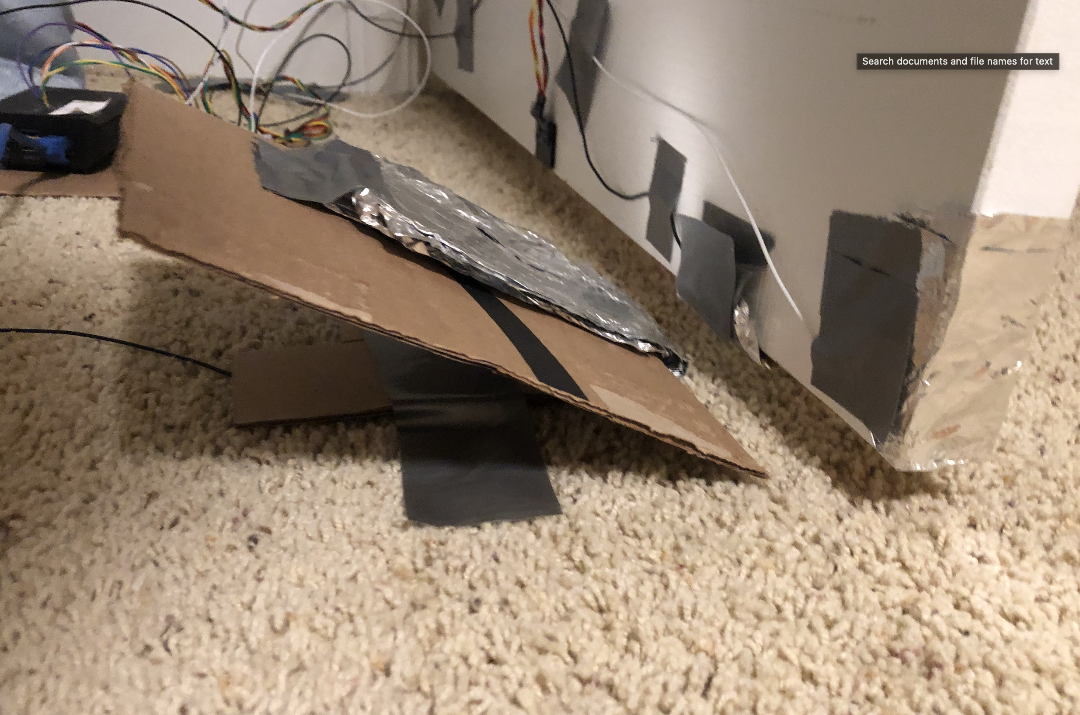
Al Contact Sensor 2 – Cardboard Pedal
Either 1 or 2 must be connected to 3.3 volts, the other to an input pin pin.
When contact is lost, the door is closing
When contact is made, the door is open

Slide 7
Al Contact Sensor Continued
The logic for the contact sensor is as follows:
Door Opening:
Door starts closed with the the door contact sensor 1 in contact with the door frame contact sensor
When the door opens, contact is lost between the door and door frame, triggering data capture
Then the door contact sensor 2 comes in contact with the cardboard pedal, then the door is considered open
1 second of data is captured before the open event and 1 second is captured on door close
LED lights up when the system is read for the next door event
Same process for door closing, except in reverse
Implemented in DataCollector(2).py

Slide 8
Setup
Direct ethernet connection between pi and laptop is preffered if you want to look at like signals
Can ssh into the pi using raspberrypi.local as the ip address
Wifi works well for data collection

Slide 9
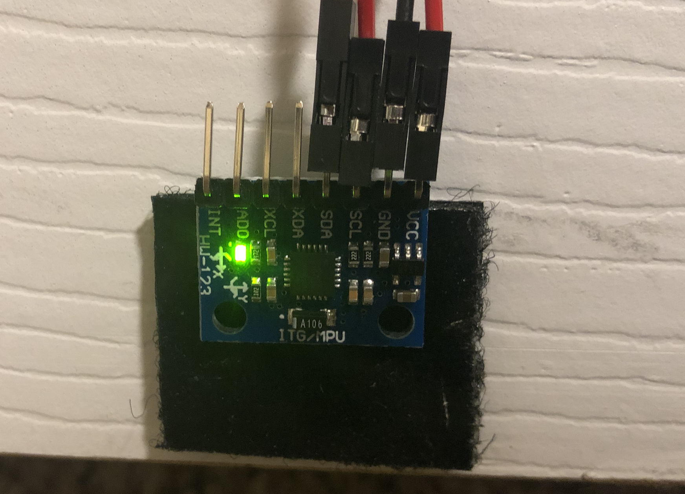
MPU6050
XYZ Accelerometer and Gyroscope (6 channels)
Uses I2C to talk to pi
Need to enable in pi interfaces and boost to 400 KHz
Sample rates can go from 25 to 1000Hz
I2C can’t handle more than ~250 Hz from experimentation
100 Hz is already overkill
Accelerometer and Gyroscope scaling and sample rate is set by code on MPU6050 connection
Test with MPU6050.py

Slide 10
MPU6050
Has a 1024 byte FIFO buffer which stores synchronously sampled accelerometer/gyrochannels
Live readings from registers are NOT synchronous
Each channel uses 2 bytes, so at the lowest sampling rate of 25 Hz, this buffer filles up within 1024/(12*25) = 3.4 seconds
I have built a threaded buffer to handle reading from the FIFO, good to about 250 Hz, which is way more than we need

Slide 11
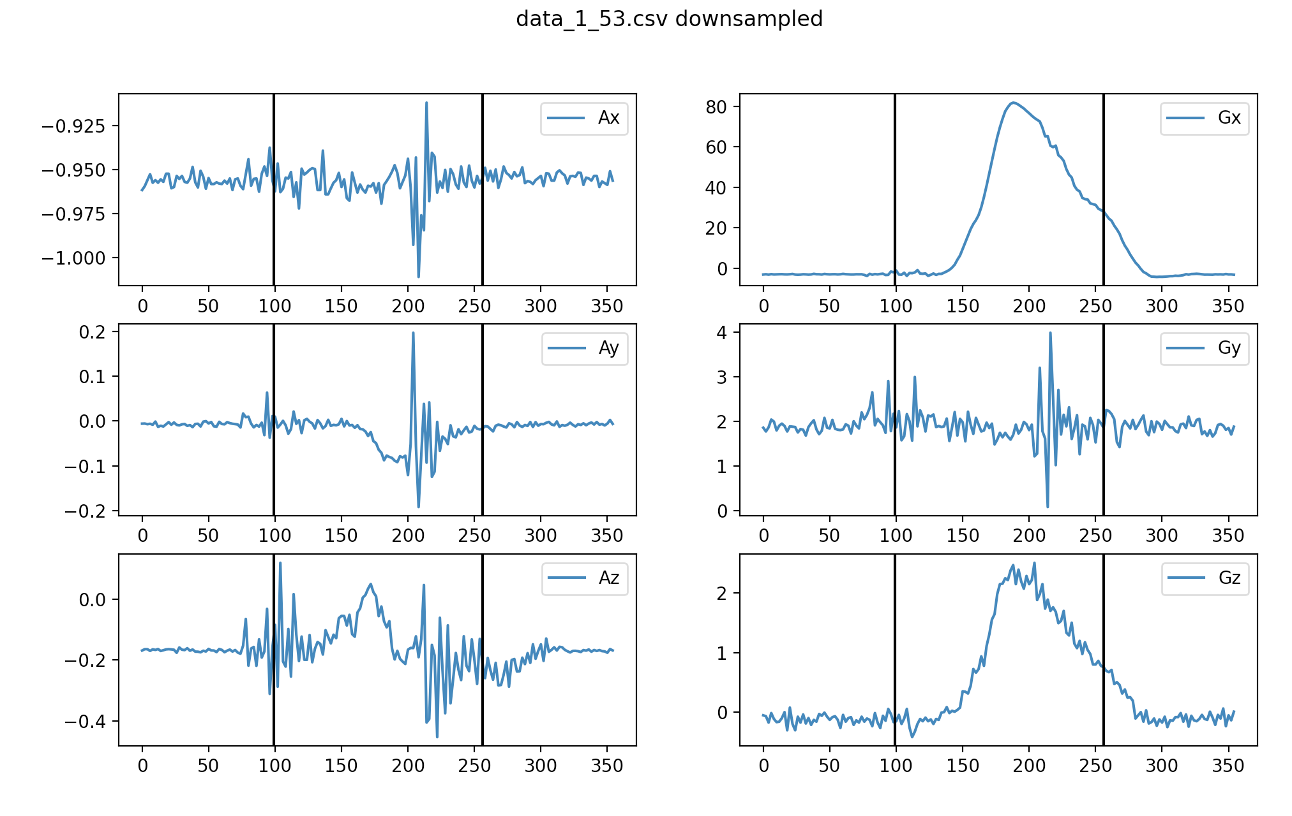
MPU6050 Data
Accelerometer yscale is in gs (9.81 m/s^2)
Gyroscope yscale is degrees/s
The plots here is a door opening data as marked by the plot title (data_1_85.csv) which corresponds to the data file. (data_0_85.csv) would be door closing.
First black line is the door losing contact with the door frame, second is making contact with the pedal contact sensor

Slide 12
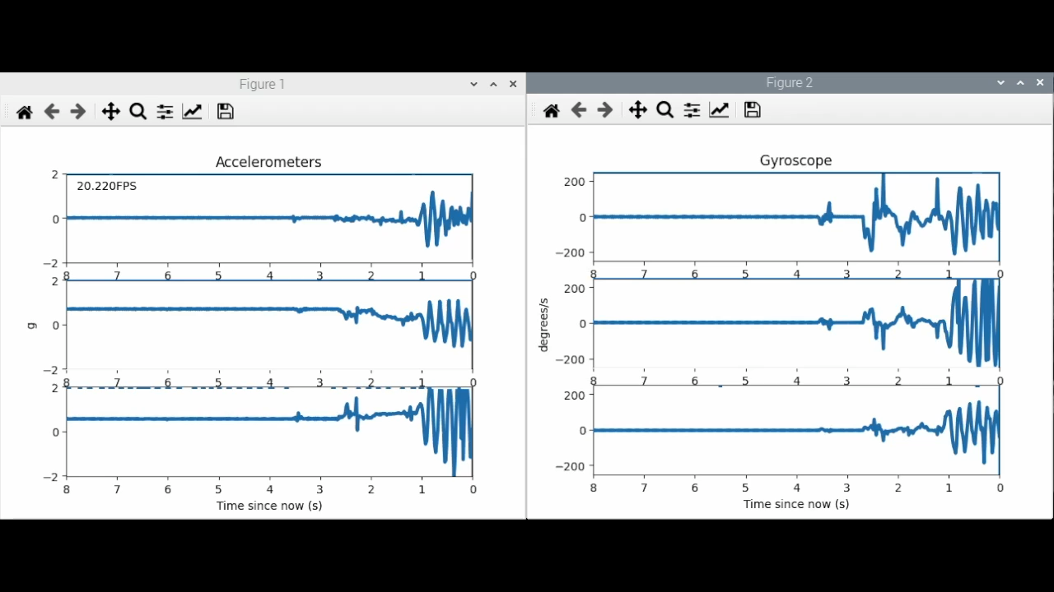
MPU6050 Oscilloscope
I built an oscilloscope for this sensor that runs on the pis
Need to VNC in and run MPU6050LivePlot2.py
Somewhat buggy due to I2C and live plotting, maybe too much to handle by a weaker pi (I have a pi 4 8GB)
Best FPS will come from direct ethernet connection

Slide 13
Data Classification
First we need a way to tell when a door is opening or closing so that we can select the data within that window to use for classification
Then we need a model(s) of some sort to guess whether it was opening or closing

Slide 14
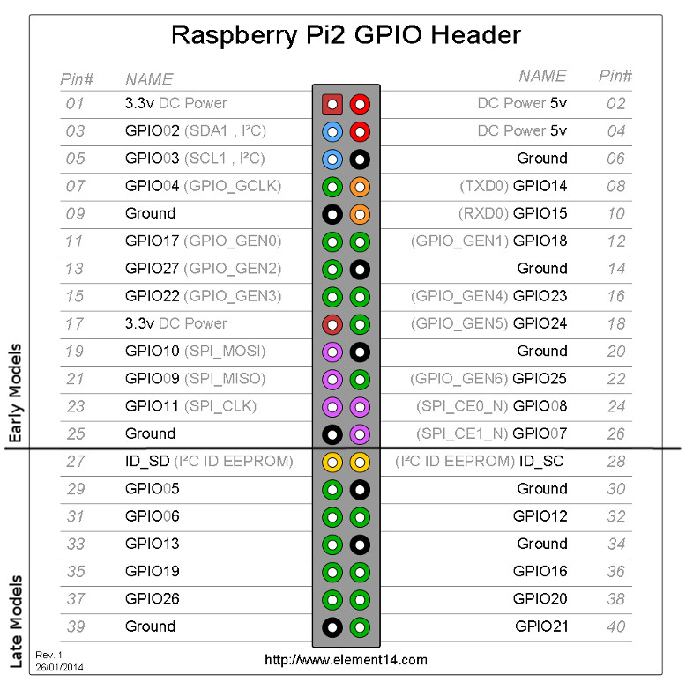
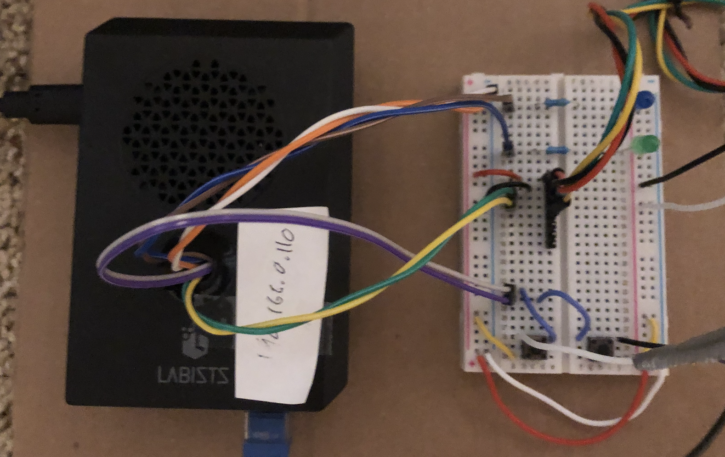
Wiring
 | Pi
Pedal Sensor | 35 | GPIO19
Door frame sensor | 31 | GPIO26
Door Sensor 1 | 1 | 3.3V
Door Sensor 2 | 1 | 3.3V
LED | 33 | GPIO13
MPU6050 | Pi | Description
VCC | 1 | 3.3V
GND | 6 | Ground
SCL | 5 | GPIO5
SDA | 3 | GPIO3

